Slide 1
U.S. Department of Education
Website UI Redesign
Slides template from: slidesgo.com

Slide 2
Project Overview
Authors: Parisa Mardanlou, Kayla Haas, Gabrielle Mirand (first week)
Timeline: 4+ weeks
Roles: UX/UI Design
Tools used: Figma, Figjam, Google workspace, Canva, Trello, slidesgo.com

Slide 3
Table of contents
01
02
03
04
Site Evaluation
User Research
UI Redesign & Testing
Prototypes

Slide 4
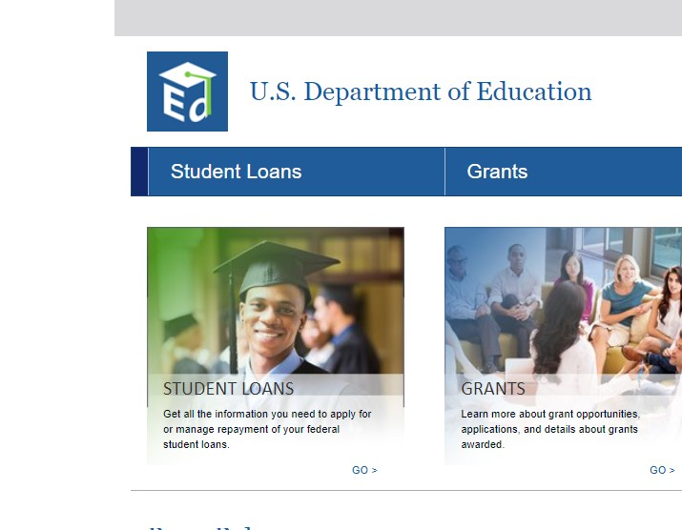
01 User Research

Slide 5
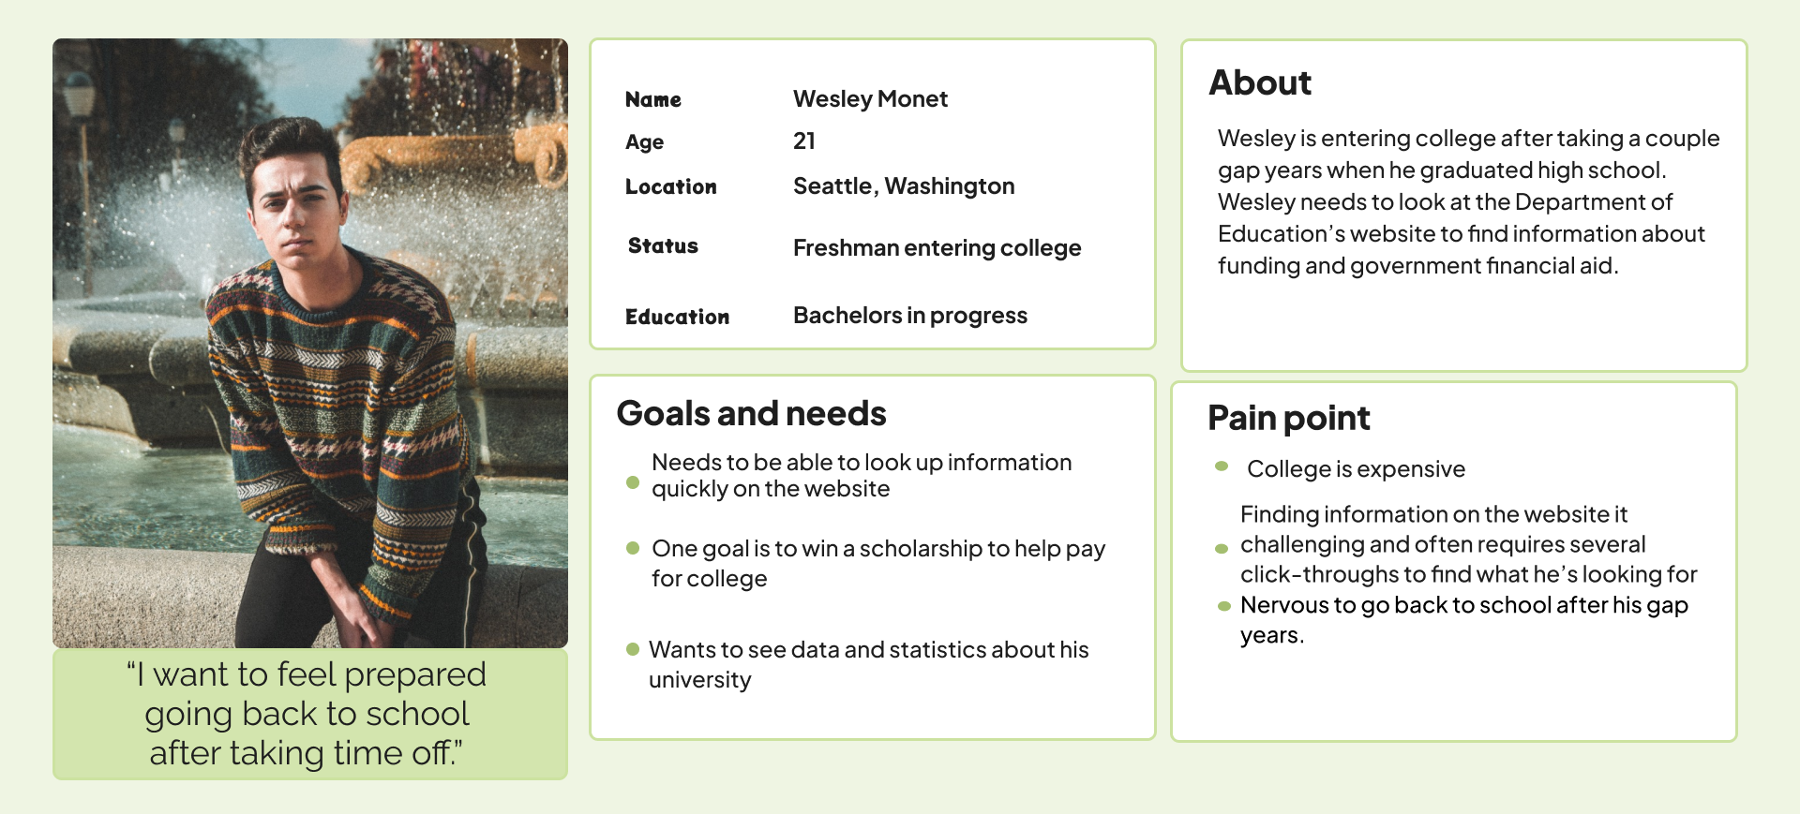
Protopersona

Slide 6
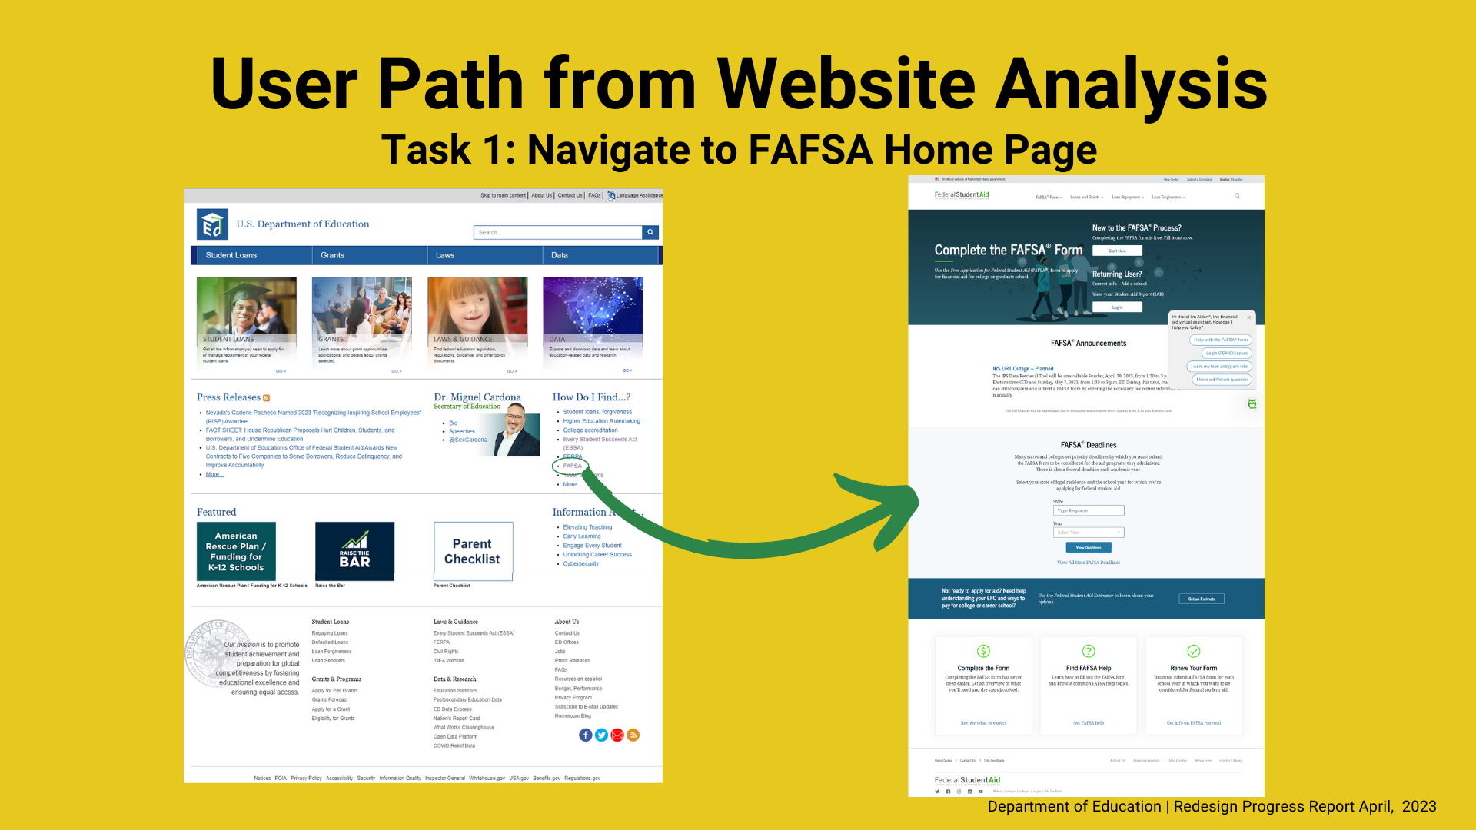
For our user to find the FAFSA home page on the original website, they would have to look over the entire page and find the link off to the left, nestled with various unrelated links.

Slide 7
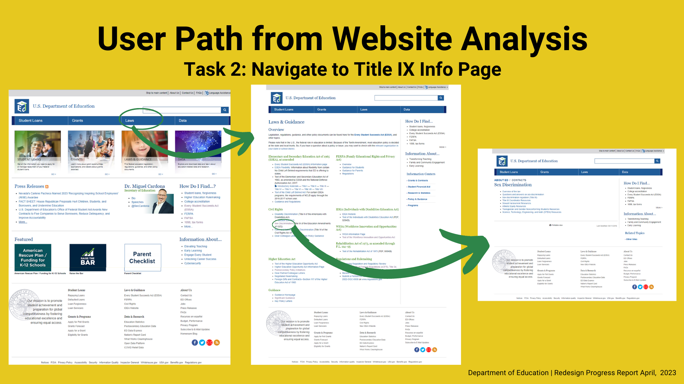
For our user to find the Title IX page, they would need to click on the Laws header, click the link nestled off to the right, before landing at the intended page.

Slide 8
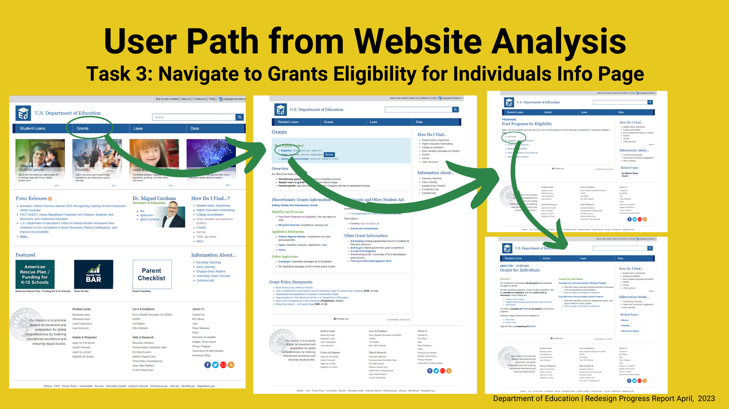
For our user to find the Grants Eligibility page, they would click on the Grants header, then another link at the top of the page, then another link to the Grants page.

Slide 9
Usability Testing: Tasks Results
Grants
FAFSA
90%
80%
Users found the Grant Programs by Eligibility page 90% of attempts.
Users navigated to the FAFSA page from the home page 80% of attempts.
Usability tests tasked users with beginning at the Department of Education’s home page, navigate to the Grants, FAFSA, and Title IX information pages.
50%
Title IX
Users arrived at the Title iX page from the home page 50% of attempts.

Slide 10
Usability Testing: User Feedback
Navigation and organization were the major themes in our users’ pain points.
User #1
User #2
“This site should be organized by categories most visited.”
“Things aren’t easy to see.”
User #3
User #4
“I read things quickly in my jon and often do a tone of research. That was not easy.”
“It’s super blah and needs to be revamped, reorganized.”

Slide 11
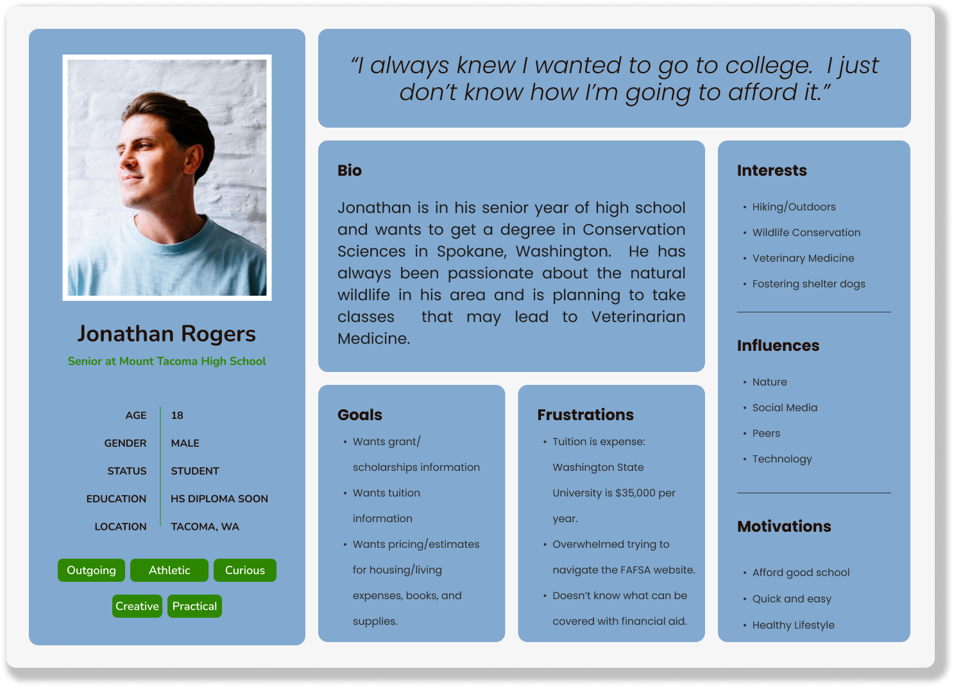
User Persona
Meet Jonathan!
He is a senior in high school that needs to find information on financial aid for his upcoming freshman year of college.
Scholarships and grants are also things he wants to research.
He is concerned about pricing and feels overwhelmed navigating the Dept. of Ed.’s website.

Slide 12



Navigation and Sitemap Evaluations
After we identified our user persona, gathered statistics from website flow tests and user testing, we continue to evaluate the Department of Education’s website. We will now focus on the navigation and sitemap structure.

Slide 13
02 Site Evaluation

Slide 14
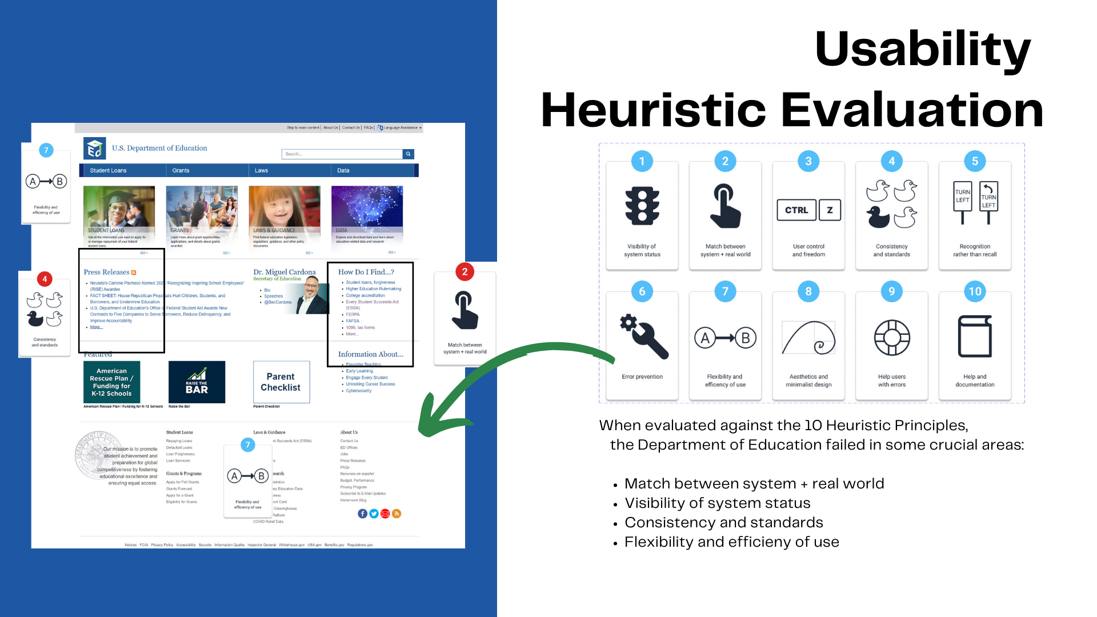

Slide 15
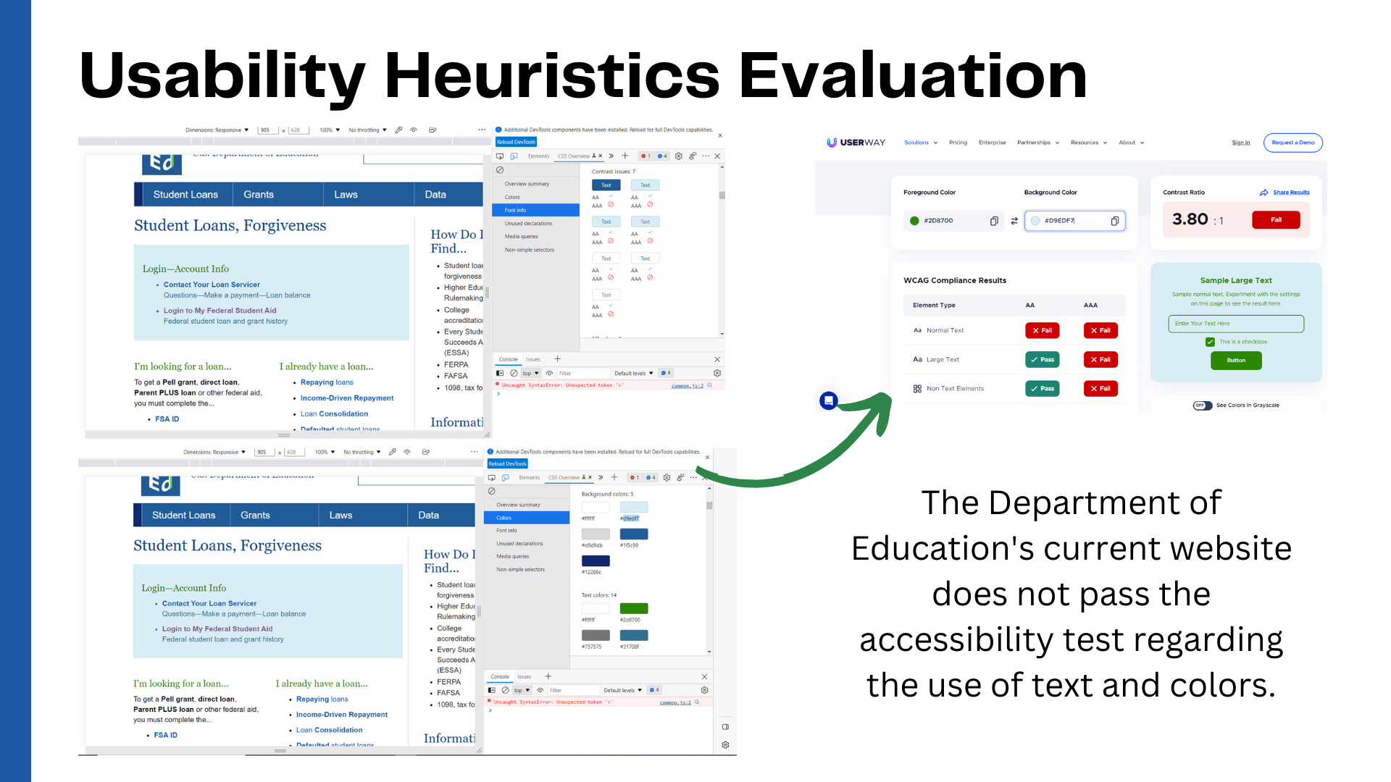

Slide 16
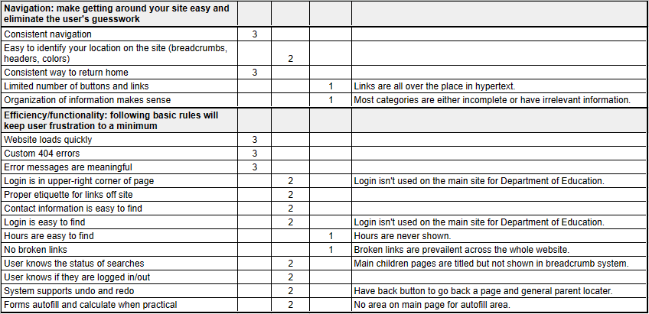
Navigation Heuristics Evaluation
Evaluation results indicate navigating the current website is difficult. The layout is cluttered, complex, and frustrating to use.

Slide 17
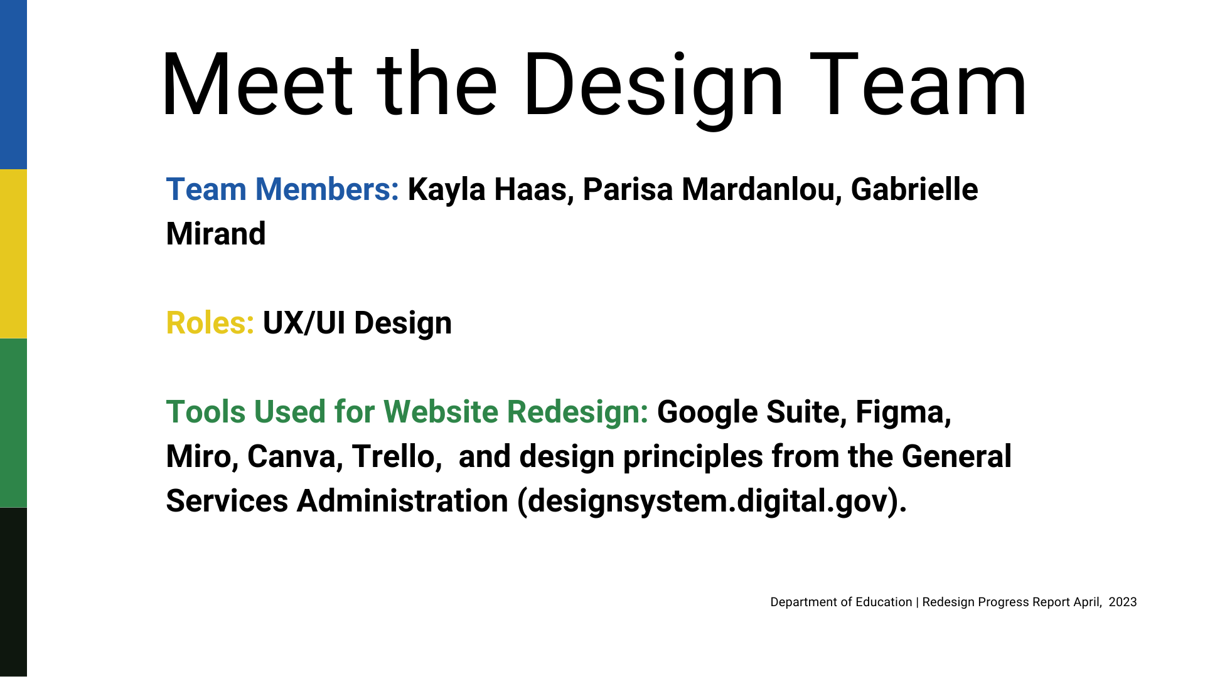
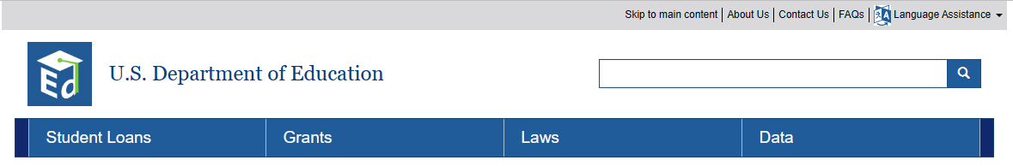
Identifying Navigational Components and Hierarchy
Current Utility Bar:
Hard to see and blends into the website utility bar.
Search Bar:
Standard and easy to see.
Current Navigation Bar:
Deceiving on content and not exclusive to the category listed

Slide 18
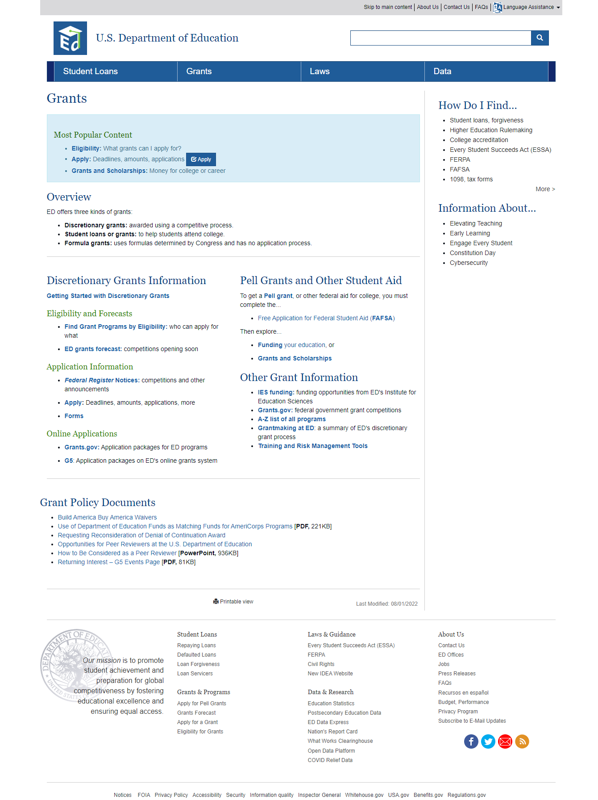
Example used: Grants page (top half)
Identifying Navigational Components and Hierarchy
25% of page is for “other information”
The only grants for college students. All loans, grants, and work study is done through FAFSA in ‘Student Loans’.

Slide 19
03 UI Design & Testing
In this phase of the Department of Education website redesign, we focused on further refining elements of the UI and usability testing. We will also focus on creating a responsive web design for desktop to mobile and page layout.

Slide 20

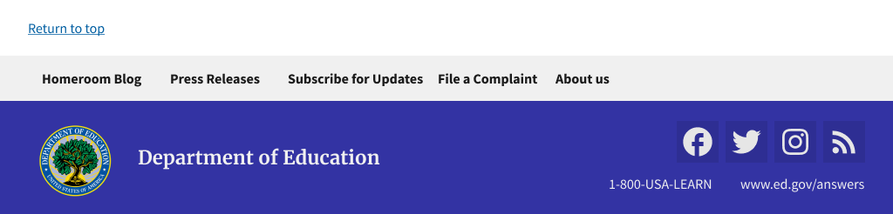
Header & Footer Navigation (Desktop)
Colorful, original, relevant icon: Official Seal of Department of Education
Search bar remains clear to see and access
Footer has similar look to the header above and allows for subscribing to social media and email notifications to current news briefs.
Figma Link

Slide 21
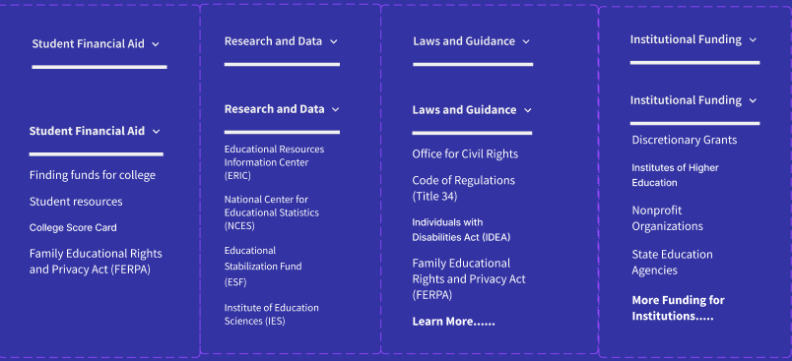
Header & Footer Navigation (Desktop)
Categories have been updated to reflect a more organized system: financial aid for students, educational research, a place to look up laws and policies related to education, and funding related to institutions.

Slide 22
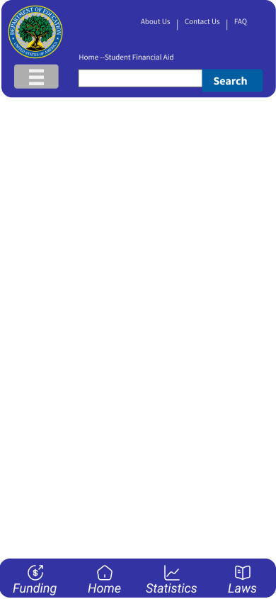
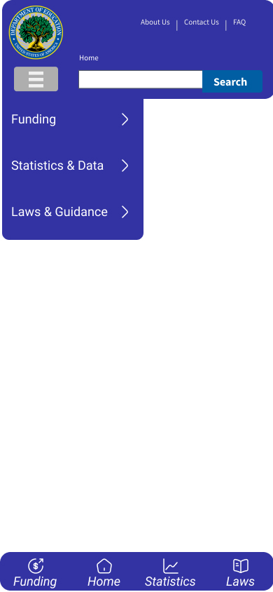
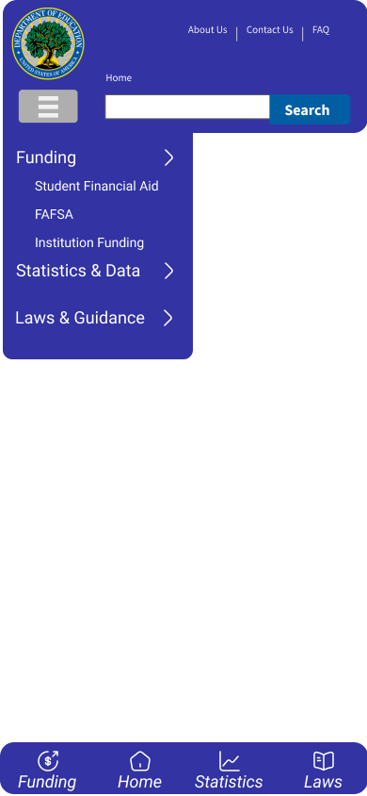
Header & Footer Navigation (Mobile)
The mobile navigation header provides quick access to important links and search. The hamburger menu expands to reveal the same categories as on desktop.
*NOTE: The mobile version displays Student Financial Aid and Institutional Funding combined into one category, Funding. This maximizes screen space and condenses information further for ease access.

Slide 23
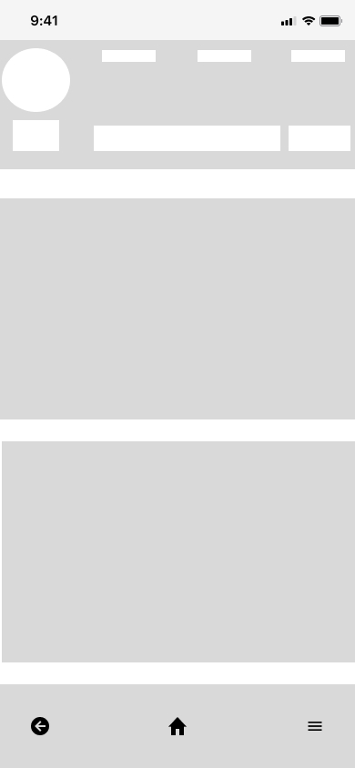
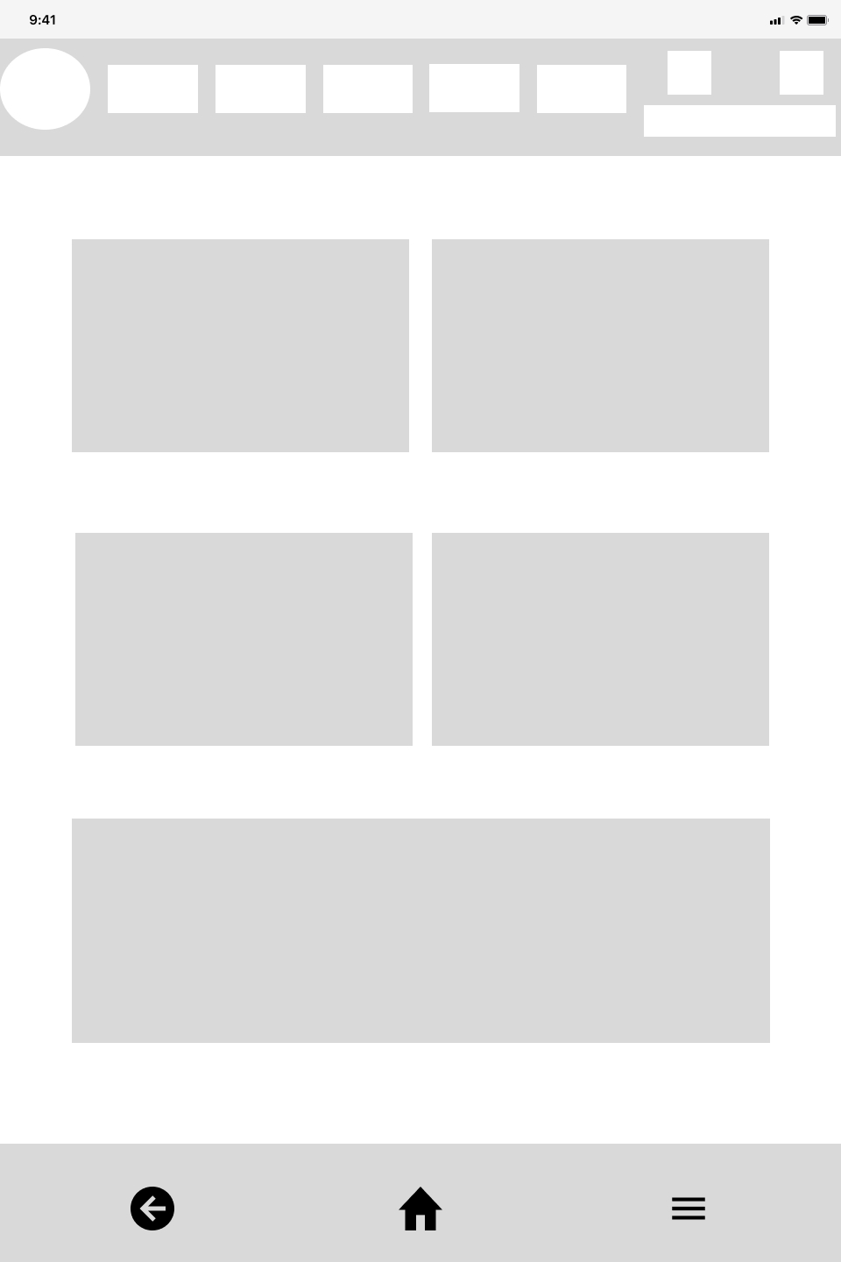
Wireframing (Mobile)
The mobile wireframes for a tablet and phone have responsive web design built in, accommodating the varying screen sizes. Navigation was largely moved from the top to bottom.
Surface Pro tablet
iPhone 14

Slide 24
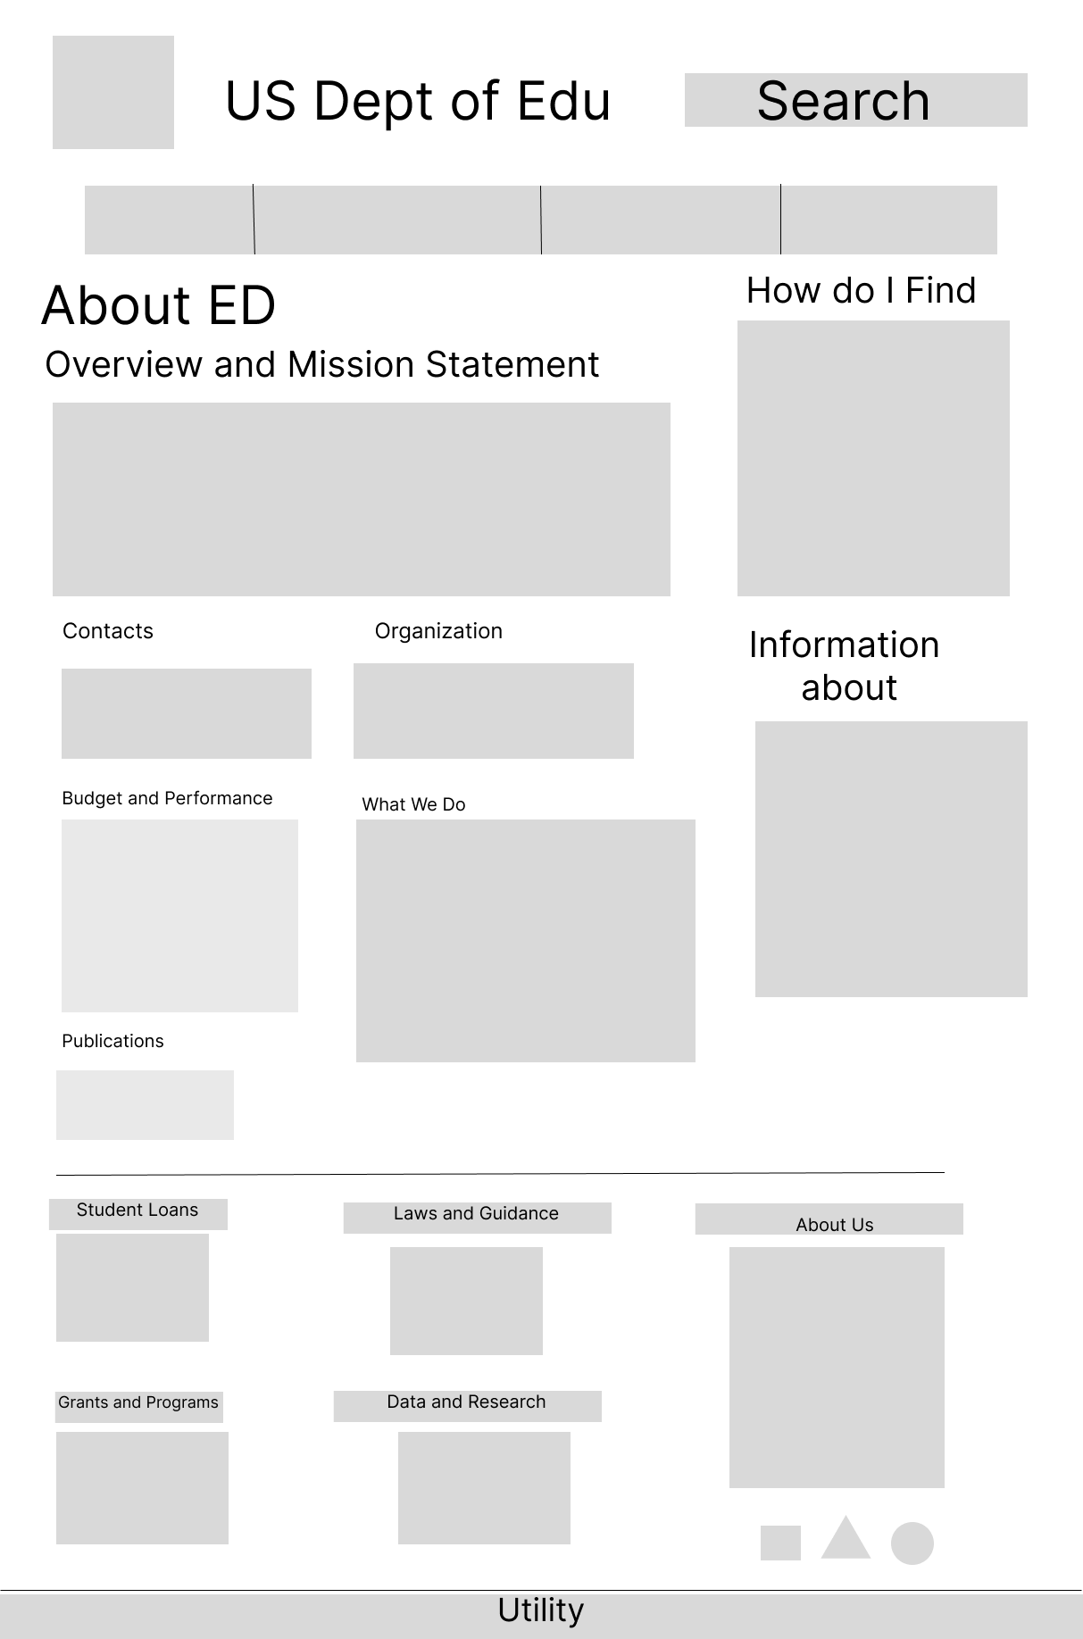

Wireframing (Desktop)
The desktop wireframes went through a couple versions, with different placements of the header elements, and the tile layout of the content taking advantage of the scrollable vertical space.
*The logo used until this point in the project was the incorrect version. All logos moving forward have been corrected.

Slide 25
04 Prototypes

Slide 26
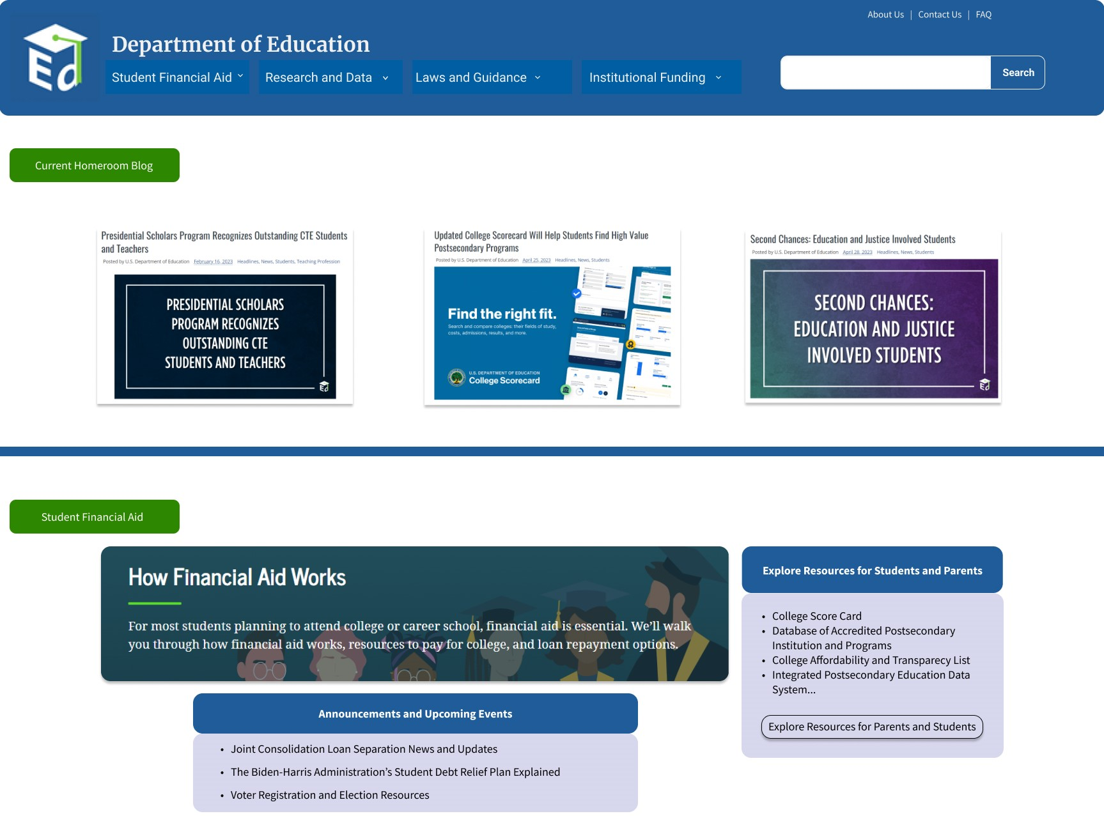
Prototype (Desktop)
Link to Figma Prototype

Slide 27
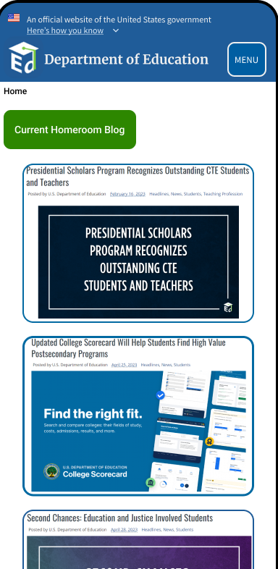
Prototype (Mobile)
Link to Figma Prototype

Slide 28
Usability Tests (new design)
User tests have not been conducted with the new design, but users are expected to complete the 3 tasks with 100% accuracy:
Find the FAFSA process
Navigate to the Guidance page
Find more information on K12 education

Slide 29
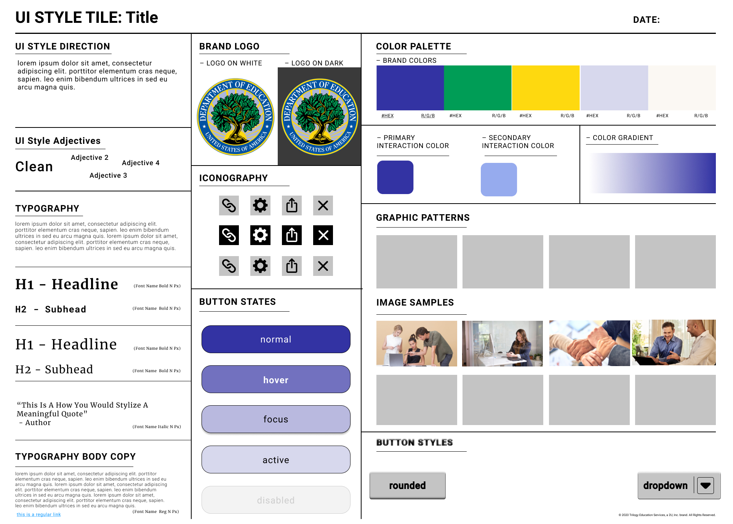

Redesigned UI Style Guide
Our UI style was influenced by the colors of the official Department logo. Soothing green, official blue, and cheerful yellow are excellent choices for education.

Slide 30
Conclusion
Following the USWDS guidelines and the Department of Education’s branding guide did lead to a few constraints on design elements and creative freedoms. With that being said, it did offer a large library of resources that did help with frequently used elements and kept a strong continuity throughout the design process.
USWDS Guidlines
Department of ED Guidelines
Major areas of improvement for this site were:
Site Structure: Many elements were outdated, missing, or misleading.
Organizing information: Text heavy pages, without strongly established sections made navigation, usability, and left an overall feelings of frustation for many users.
Additionally, each Office under the Department of Education has a different style, structure, and functionality. Maintaining continuity throughout the whole Department would be difficult at this time

Slide 31

Suggestions and Comments
This was a great website to help develop our skills and UX/UI Designers. It has been a website widely used by many students, educators, and personnel working on educational legislature. Since it hasn’t been revamped in quite some time, it was especially useful seeing how much has changed over the last decade and what a great opportunity it would be to utilize the options that are available currently.
With respects to the major areas of improvement from the previous slide, we also suggest revisiting the branding guide for the Department of Education. Brighter color and card/section/chunking information helps with accessibility and with user focus. Using visual aids such as icons, photos, or animations would also aid in usability and site orientation.

